Slide 1
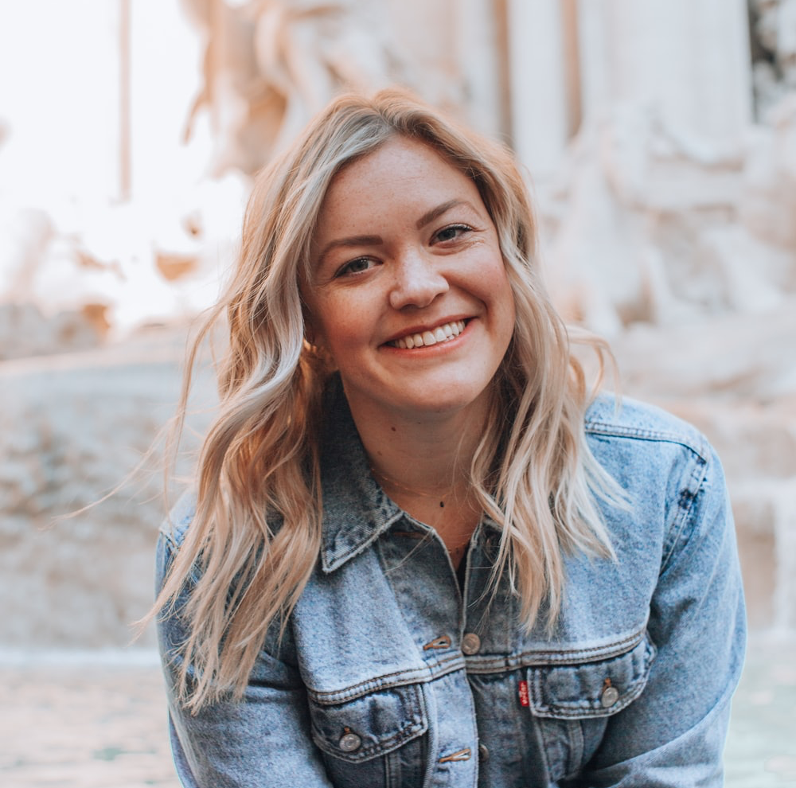





sally_lookin_for_housin | Star User
Hi! My name is Sally. I’m 27 years old and I love being active. I’m a busy girl,
I work at a Law Firm so I’m gone most of the time. I’m clean and responsible and just looking to have a good time!
ratings
Edit Profile
Edit Picture
ISO: A pink pretty house...
ISO a animal friendly house...
ISO a trash house...
...
2
Jan 1st
14
Dec 3
8
August 5

Slide 2

Hi! My name is Sally. I’m 27 years old and I love being active. I’m a busy girl,
I work at a Law Firm so I’m gone most of the time. I’m clean and responsible and just looking to have a good time!
ratings
Edit Profile
Ralf_Petersen
Sally was great to work with, even though we didn’t end up being a good match she was quick to respond and very helpful.
jane_acreman_
I hated Sally. Super flakey and mean.

Slide 3




Hi! My name is Sally. I’m 27 years old and I love being active. I’m a busy girl,
I work at a Law Firm so I’m gone most of the time. I’m clean and responsible and just looking to have a good time!
ratings
Edit Profile
Sally_lookin_for_housin
Hi Ralf! I saw your ISO the other day...
Hi Jane! Looking for 2 person apartment? I got that...
On 12/31/12
On 12/31/12
You messaged Ralf_Petersen
You messaged
Jane_Acreman_2
...

